Slide 1



Introduction to Data Science
PROJECT 2
Presented by: Saloni Chitre , Burhan Latief Dar

Slide 2
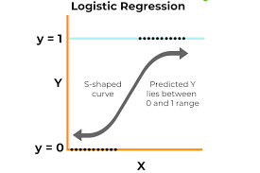
What is Logistic Regression?
Logistic Regression is a supervised machine learning algorithm used for binary classification tasks.
Unlike Linear Regression, it predicts the probability of the target variable belonging to a specific class (e.g., "yes" or "no").
The output is constrained between 0 and 1 using a sigmoid function.

Slide 3

One-Hot Encoding for Categorical Features:
Transformed categorical variables into numerical ones using one-hot encoding.
Example: job becomes multiple columns (e.g., job_admin., job_technician, etc.).
Dropped the first category for each feature to avoid multicollinearity.
Feature Standardization:
Applied standardization to numerical features for consistency:
Converted all numerical values to have a mean of 0 and a standard deviation of 1.
Reason: Logistic Regression is sensitive to feature scaling.

Slide 4

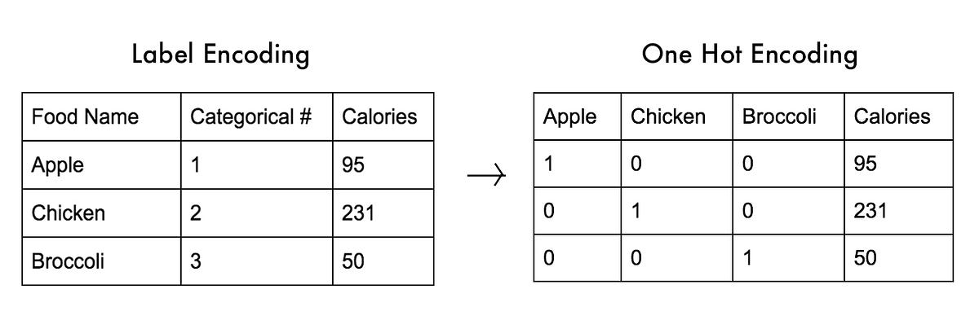
One hot encoding

Slide 5
Train-Test Split:
Divided the data into training and testing sets:
Training Set: 70% of the data for model training.
Testing Set: 30% of the data for evaluation.
Summary of Preprocessed Data:
Number of Features (After Encoding): 53.
Training Set Size: 28,831 rows.
Testing Set Size: 12,357 rows.

Slide 6

Predictions:
Output Variables:
y_pred (Predicted Labels): Class predictions (0 or 1) for the test dataset.
y_pred_prob (Predicted Probabilities): The likelihood of each test observation being in class "yes".

Slide 7
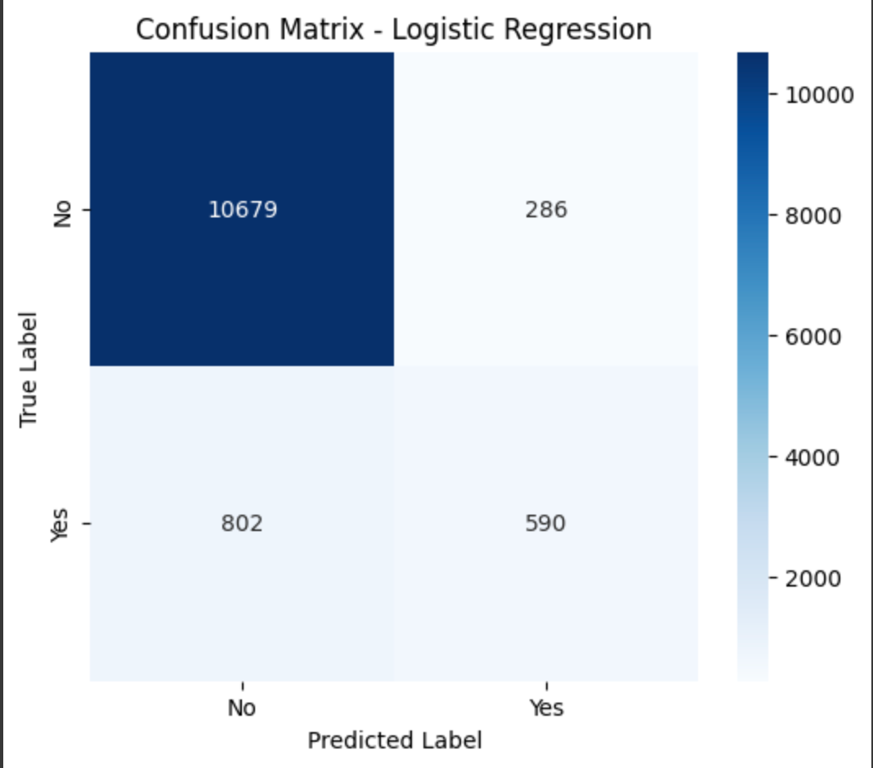

Slide 8
Confusion Matrix
Represents the counts of True Positives, True Negatives, False Positives, and False Negatives.
True Negatives (10,679): Non-subscribers correctly identified as "no".
False Positives (286): Non-subscribers incorrectly classified as "yes".
False Negatives (802): Subscribers missed by the model.
True Positives (590): Subscribers correctly classified as "yes".

Slide 9

Insights of the confusion matrix
High True Negatives indicate strong performance in identifying the majority class ("no").
Relatively lower True Positives suggest room for improvement in identifying the minority class ("yes").

Slide 10
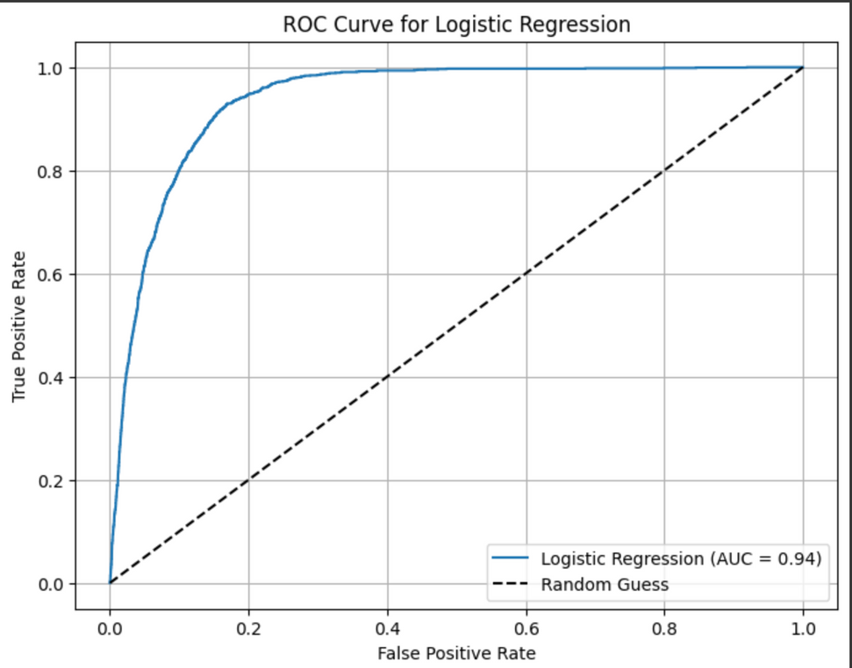
ROC Curve:
Plot Details:
X-axis: False Positive Rate.
Y-axis: True Positive Rate.
Logistic Regression AUC: 0.94.
Interpretation:
A high AUC value indicates strong model performance in separating the two classes.

Slide 11

Observations
Logistic Regression achieves high accuracy and AUC but struggles with the minority class due to class imbalance.
Precision is decent, but Recall is relatively low, indicating that the model misses many actual subscribers.

Slide 12

Key Metrics:
Accuracy: 91%
Precision (Class 1): 67%
Recall (Class 1): 42%
F1-Score (Class 1): 52%
ROC-AUC: 0.94

Slide 13
Observations for Logistic Regression Model:
High accuracy (91%) indicates strong overall prediction capability.
Precision is decent for identifying customers likely to subscribe.
Lower recall (42%) suggests many potential subscribers are missed.

Slide 14
Naive Bayes
P(C∣X)=P(X)P(X∣C)⋅P(C)/P(X)
Metrics:
Accuracy: 84%.
Precision (Class "Yes"): 38%.
Recall (Class "Yes"): 62%.
F1-Score (Class "Yes"): 47%.
ROC-AUC: 0.85.

Slide 15

Confusion Matrix:
True Negatives: 9,546.
False Positives: 1,419.
False Negatives: 531.
True Positives: 861.

Slide 16
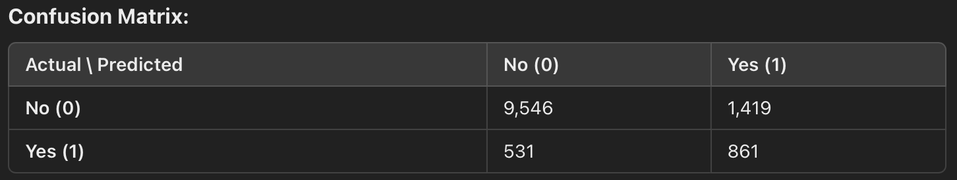
Analysis of Class Performance
Class "No" (Non-Subscribers):
Strength: High true negatives (9,546) mean the model is very effective in identifying non-subscribers.
Weakness: The high false positives (1,419) suggest that the model occasionally confuses non-subscribers as potential subscribers.
Class "Yes" (Subscribers):
Strength: A significant portion of true positives (861) is correctly identified, leading to a reasonable recall.
Weakness: The model struggles to differentiate true positives from false positives, lowering precision.

Slide 17
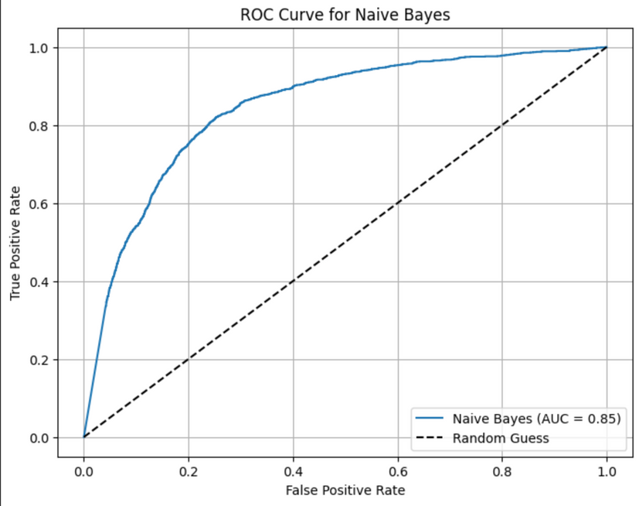
ROC Curve Analysis:
The curve shows how TPR and FPR change as the classification threshold is adjusted.
A steep curve near the top-left corner indicates better performance (low FPR, high TPR).

Slide 18

Observations for Naive Bayes model
Strengths:
Computationally efficient and easy to implement.
Handles imbalanced data better than Logistic Regression (higher Recall for "Yes").
Weaknesses:
Lower Precision and F1-Score for "Yes" due to:
Independence assumption.
Class imbalance in the dataset.

Slide 19
K-nearest Neighbour
Insights from Metrics
1. Accuracy (90%):
Strength: The model is accurate overall, with correct predictions for most instances.
Limitation: Accuracy is skewed due to the dominance of the "No" class.
2. Precision (59%) and Recall (47%) for "Yes":
Precision is better than Naive Bayes but still moderate.
Recall indicates the model misses 53% of actual subscribers.
3. F1-Score (52%):
Balances precision and recall for "Yes," showing moderate performance for the minority class.
4. ROC-AUC (0.87):
Indicates strong overall discriminatory ability of the model.

Slide 20
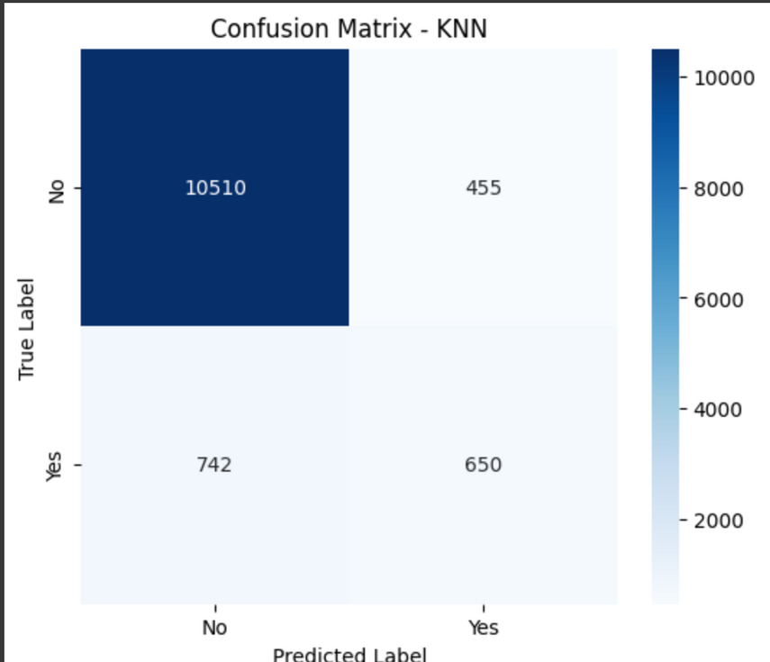
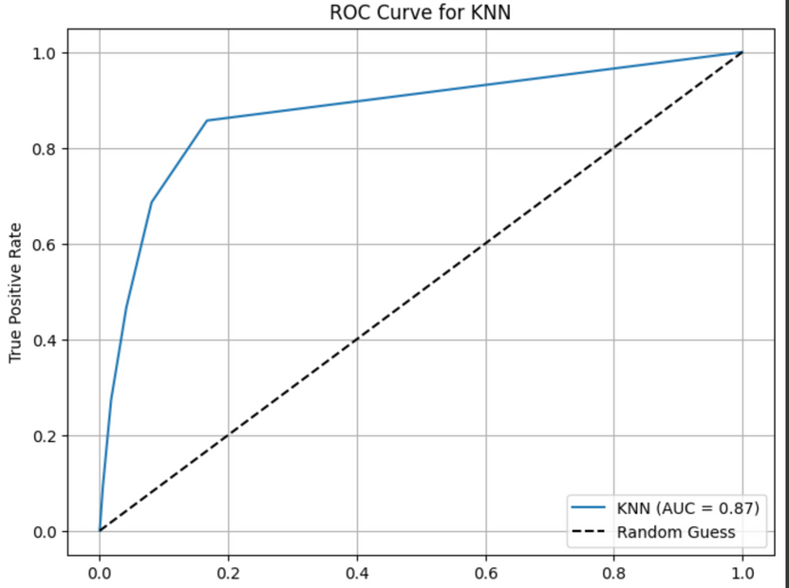
Confusion Matrix Insights:
True Negatives (10,510): KNN is effective at identifying non-subscribers.
False Positives (455): Minimal misclassification of non-subscribers as subscribers.
True Positives (650): Moderate ability to correctly identify subscribers.
False Negatives (742): Indicates improvement is needed to capture more subscribers.

Slide 21

Observations for KNN model
Strengths:
High Accuracy and AUC: Demonstrates strong overall performance.
Low False Positives: Reliable at avoiding unnecessary classifications of "Yes."
Flexible Algorithm: Easily adaptable by adjusting kk or distance metric.
Limitations:
Sensitivity to Imbalanced Data: Misses many actual subscribers (742 false negatives).
Computational Cost: KNN is slow with large datasets due to distance calculations.
Feature Scaling Dependence: Requires standardized features for optimal performance.

Slide 22
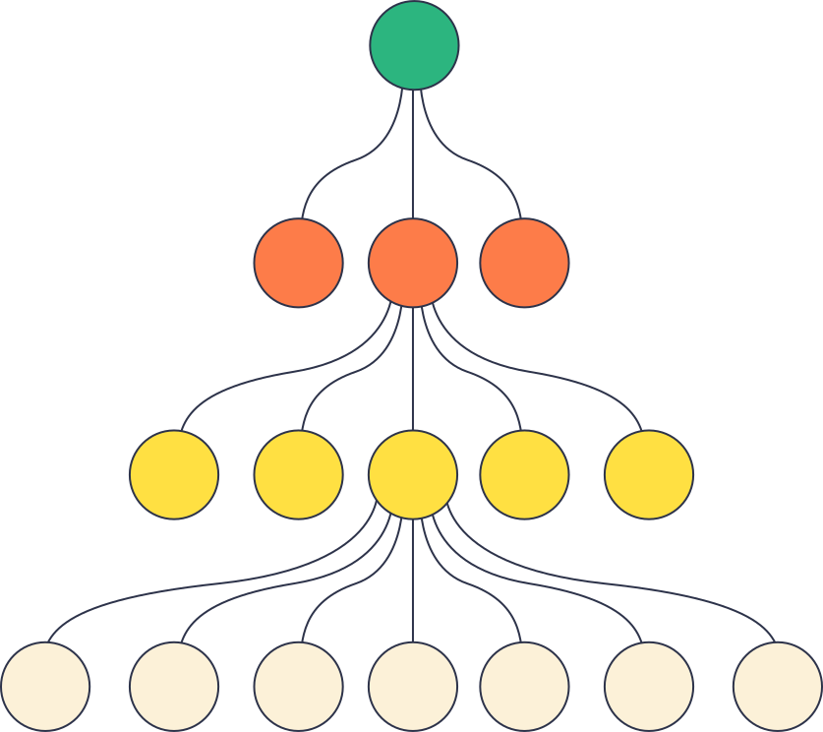
Decision Tree Model
Insights from Metrics
1. Accuracy (89%):
Strength: The model performs well overall, correctly predicting most instances.
Limitation: High accuracy is driven by the majority class ("No"), masking performance for the minority class.
2. Precision (51%) and Recall (53%) for "Yes":
Precision indicates the model has a moderate rate of false positives for "Yes."
Recall reflects a balanced ability to identify true positives but still misses 47% of actual subscribers.

Slide 23
3. F1-Score (52%):
Balances precision and recall, showing that the model handles the minority class moderately well but has room for improvement.
4. ROC-AUC (0.73):
Indicates that the model struggles to separate the two classes effectively compared to Logistic Regression or KNN.

Slide 24

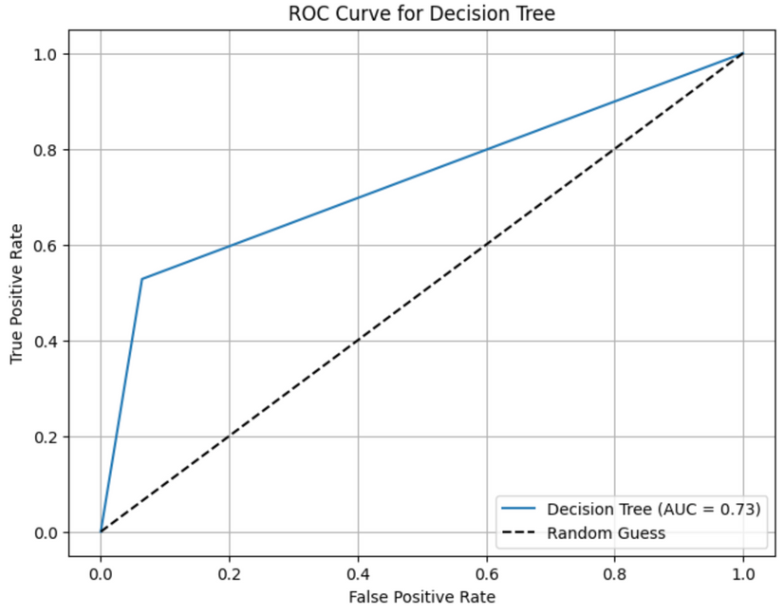
Confusion Matrix Insights:
True Negatives (10,261): Strong performance for identifying non-subscribers.
False Positives (704): Moderate misclassification of non-subscribers as subscribers.
True Positives (735): Reasonable ability to identify actual subscribers.
False Negatives (657): Suggests the need for better recall for "Yes."

Slide 25

Observations for DT Model
Strengths:
Interpretability: Easy to visualize and understand.
Non-parametric: Makes no assumptions about the data distribution.
Handles Non-Linear Relationships: Can capture complex patterns in data.
Limitations:
Overfitting Risk: Tends to overfit, especially on noisy or imbalanced datasets.
Sensitivity to Small Changes: A slight change in data can significantly alter the tree structure.
Lower AUC: Indicates limited ability to separate classes compared to Logistic Regression and KNN.

Slide 26
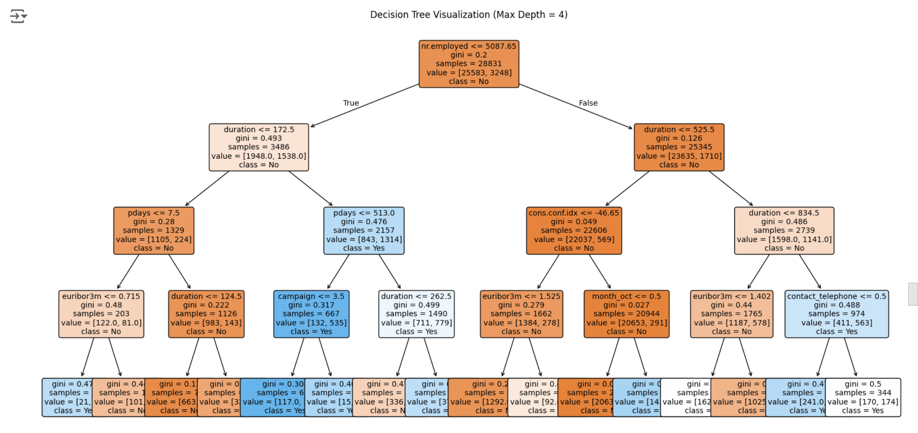

Slide 27

Random Forest Model
Metrics:
Accuracy: 92%.
Precision (Class "Yes"): 67%.
Recall (Class "Yes"): 49%.
F1-Score (Class "Yes"): 57%.
ROC-AUC: 0.94.

Slide 28
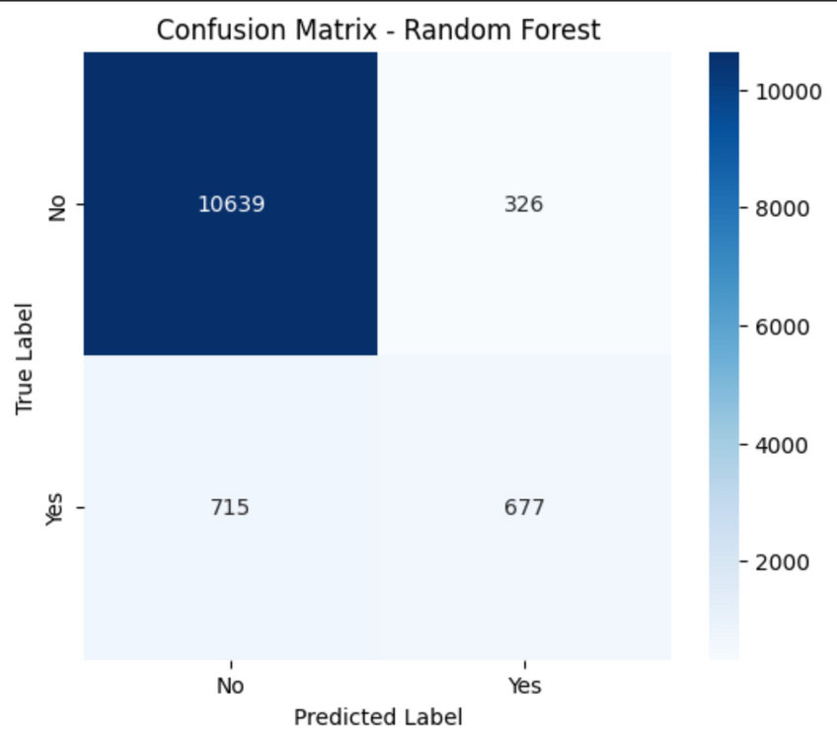
Confusion Matrix Insights:
True Negatives (10,639): The model is highly accurate for the majority class ("No").
False Positives (326): Few non-subscribers are incorrectly predicted as subscribers.
True Positives (677): Captures a reasonable number of actual subscribers.
False Negatives (715): Some room for improvement in identifying all subscribers.

Slide 29
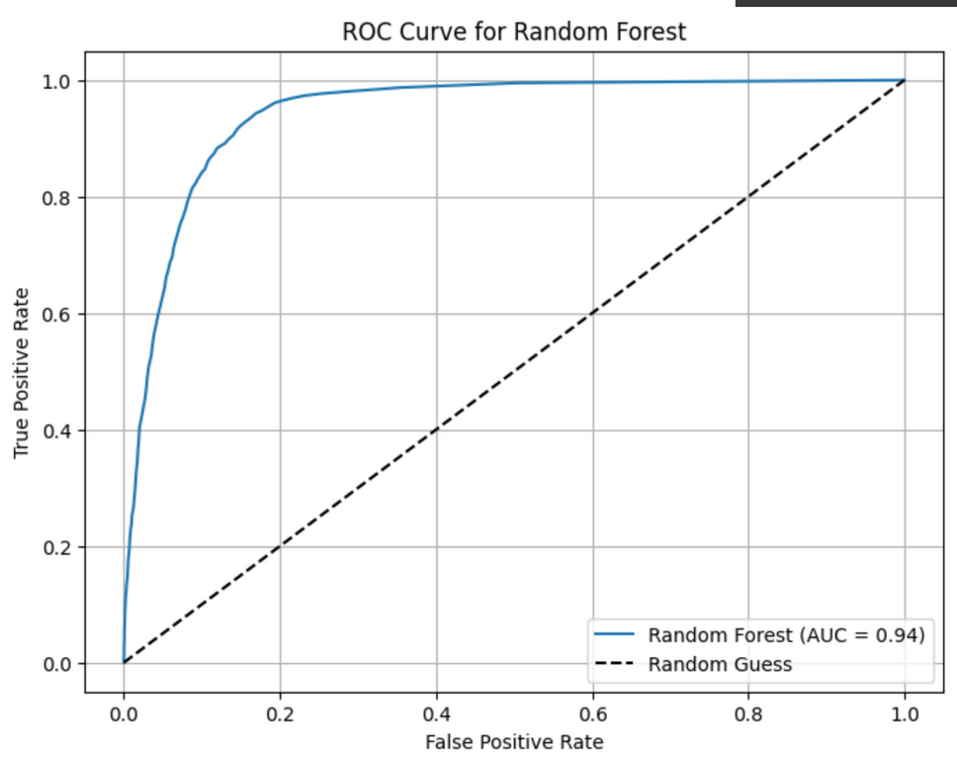
ROC-AUC:
AUC Value: 0.94 (excellent performance).
Key Observations:
High True Positive Rate with low False Positive Rate across thresholds.
Slightly better performance than KNN and Decision Tree.

Slide 30
Observations for Random Forest
Strengths:
High Accuracy and AUC: Demonstrates excellent overall performance.
Feature Importance: Provides insights into which factors influence predictions.
Robustness: Handles noisy and imbalanced datasets better than single models.
Limitations:
Interpretability: Harder to interpret compared to a single decision tree.
Computational Cost: Training and inference are resource-intensive.
Potential Overfitting: Overfitting can occur with very deep trees.

Slide 31
XGBoost Algorithm
Extreme Gradient Boosting (XGBoost):
An efficient, scalable, and high-performing implementation of gradient boosting.
Combines predictions from multiple weak learners (decision trees) to form a strong learner.

Slide 32
Metrics:
Accuracy: 92%.
Precision (Class "Yes"): 65%.
Recall (Class "Yes"): 56%.
F1-Score (Class "Yes"): 60%.
ROC-AUC: 0.95.

Slide 33

Confusion Matrix Insights:
True Negatives (10,550): High accuracy in identifying non-subscribers.
False Positives (415): Minimal misclassification of non-subscribers as subscribers.
True Positives (781): Improved ability to identify actual subscribers.
False Negatives (611): Fewer missed subscribers compared to earlier models.

Slide 34
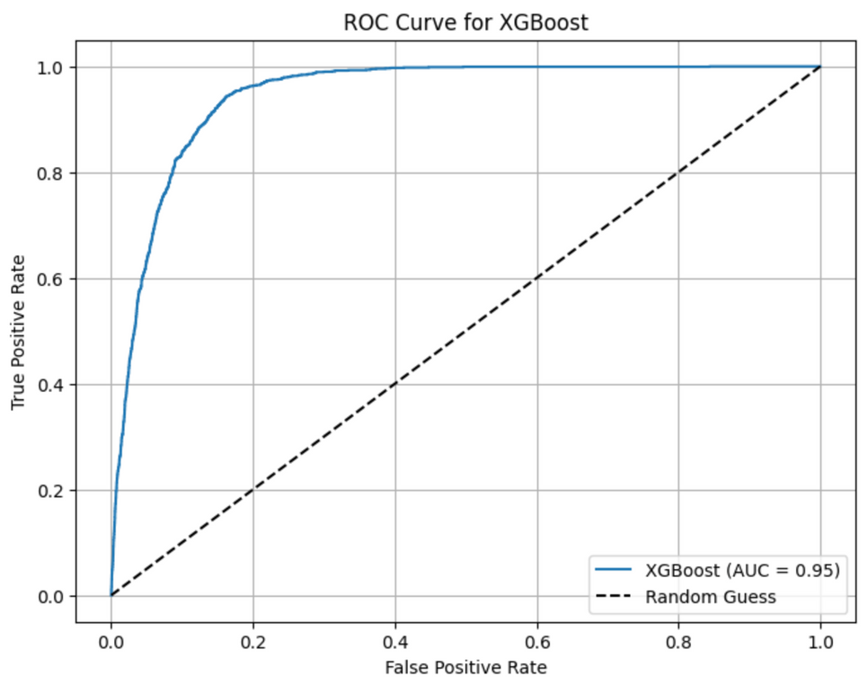
ROC-AUC:
AUC Value: 0.95 (outstanding performance).
Key Observations:
High True Positive Rate with low False Positive Rate across thresholds.
Best ROC-AUC score among all models.

Slide 35
Observations for XGBoost
Strengths:
Best Performance: Outperforms all other models in accuracy, F1-Score, and AUC.
Handles Complex Data Well: Captures non-linear relationships effectively.
Feature Importance: Provides insights into key factors driving predictions.
Limitations:
Computational Cost: More resource-intensive than simpler models.
Hyperparameter Sensitivity: Requires careful tuning for optimal performance.

Slide 36
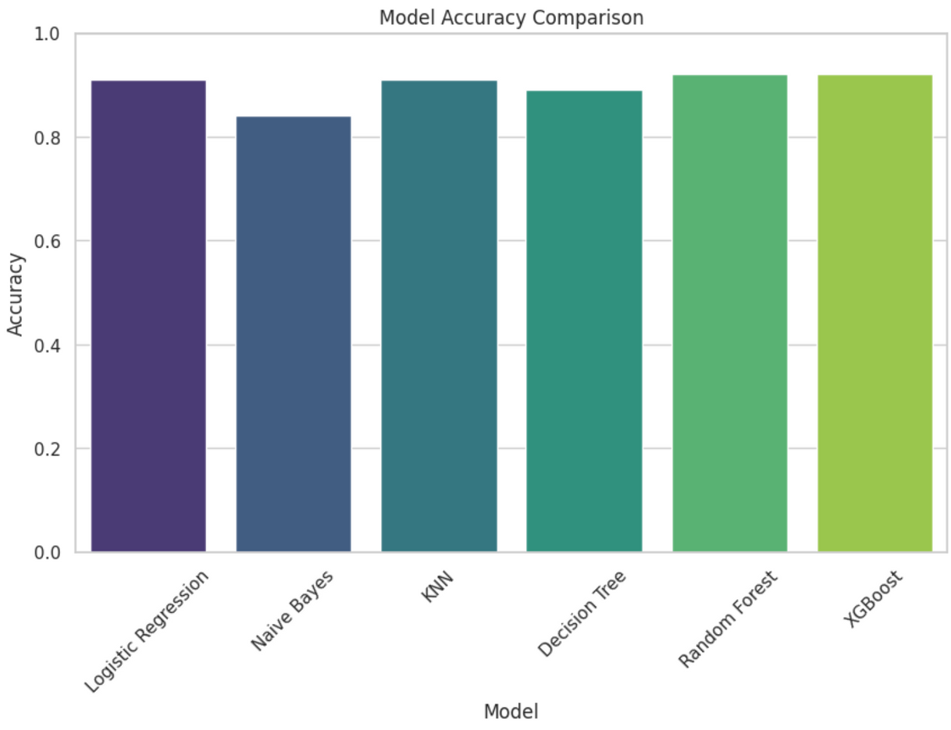
Comparative Analysis

Slide 37


